Slide 1

Computer Organization and Assembly Language Lab
Lab 05
Flag Register, Jump Instruction, Loops
National University of Computer and Emerging Sciences, Islamabad

Slide 2
Flag Register
The flag register is a 32-bit register named EFLAGS that control certain operations and indicate the status of the 80386.
The low-order 16 bits of EFLAGS is named FLAGS and can be treated as a unit
15 14 13 12 11 10 9 8 7 6 5 4 3 2 1 0
 |  |  |  | O | D | I | T | S | Z |  | A |  | P |  | C

Slide 3
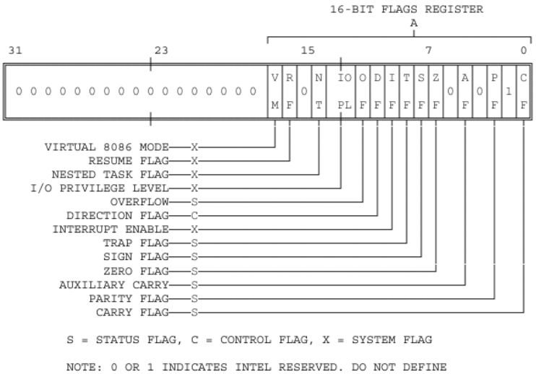
Continue….

Slide 4
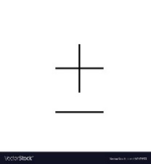
Zero Flag
The Zero flag is set when the result of an arithmetic operation equals zero.
0 | 0 | 0 | 0 | 0 | 0 | 1 | 1
0 | 0 | 0 | 0 | 0 | 0 | 1 | 1
ZF
1
0 | 0 | 0 | 0 | 0 | 0 | 0 | 0

Slide 5
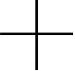
Carry Flag
When the result of an unsigned arithmetic operation is out of range, the Carry flag is set to 1
1 1 1 1 1 1 1
1 | 1 | 1 | 1 | 1 | 1 | 1 | 1
0 | 0 | 0 | 0 | 0 | 0 | 0 | 1
CF
1
0 | 0 | 0 | 0 | 0 | 0 | 0 | 0

Slide 6
Parity Flag
Parity Flag is set when the result of an arithmetic operation has an even number 1 bits.
mov al, 10001100b
add al, 00000010b ; PF = 1
sub al, 10000000b ; PF = 0

Slide 7
Auxiliary Flag
The auxiliary flag is set when there is a carry from bit 3 to bit 4.
1 1 1 1 1
0 | 0 | 0 | 0 | 1 | 1 | 1 | 1
0 | 0 | 0 | 1 | 0 | 0 | 0 | 1
AC
1
0 | 0 | 1 | 0 | 0 | 0 | 0 | 0

Slide 8
Sign Flag
The Sign flag is set when the result of a signed arithmetic operation is negative.
mov al, 1
sub al, 2 ;AL= -1 SF = 1

Slide 9
OverFlow Flag
The overflow flag is set when result of signed arithmetic result is out of range
mov al,+127
add al,1 ; OF = 1

Slide 10
Labels
A label is an identifier that is followed by a colon.
They are simply a way to tell the assembler that those locations have symbolic names.
Example
Label1:
Above:
START:

Slide 11
Jump Instruction
JMP command is to jump to a specific line or block of code. That line or block of code is identified by a label.
Syntax: JMP [label]
START:
…..
JMP START

Slide 12
Loop
The keyword ‘loop’ runs a static loop of specific number of times and that number is stored in the Counter register, CX.
mov cx,5 ; loop runs 5 times
loop1:
….
loop loop1

Slide 13
Flag | Set | Cleared
Carry Flag (CF) | CY | NC
Parity Flag (PF) | PE | PO
Auxiliary Flag (AF) | AC | NA
Zero Flag (ZF) | ZR | NZ
Sign Flag (SF) | NG | PL
Interrupt Flag (IF) | EI | DI
Direction Flag (DF) | DN | UP
Overflow Flag (OF) | OV | NV

